Slide 1
Data Archive Infrastructure and Access
Narges Zarrabi (SURFsara)
Arthur Newton (SURFsara)
UvA HPC Course : Data Management
3rd July 2018

Slide 2
Data Archive - Long-term storage
Long-term storage of data
Storage medium: Tape → high latency
Powerful transfer protocols (gridfTp, rsync, scp)
Easy access from HPC services lisa and cartesius via NFS mounts → use archive as yet another directory

Slide 3

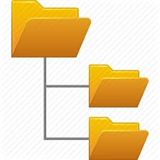


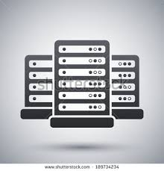
Data Archive Infrastructure
Data Archive infrastructure
Direct access to Archive (Secure connection, SSH)
Access via HPC (NFS mounts, User sees the archive as another folder)
Workflow employing Archive from compute clusters at SURFsara:
User logs in to Lisa/Cartesius
Do your computations on the data
Copy data back to archive (tape)
Archive
Tape
Lisa/Cartesius
Staging Data
Login
Archive Node (Disk)
Direct login
Notes:
Workflow employing Archive from compute clusters at SURFsara:
User logs in to Lisa/Cartesius
Archive is mounted via NFS → User sees the archive as another folder
Copy data to HPC with the normal system commands
→data is still on tape, but commands on HPC have been adopted to that
Do your computations on the data
Copy data back to archive (tape)

Slide 4
Archive Usage – Best practices
Try to store files of significant size (> 1 GB) as much as possible. Smaller files will always be accepted, but will lower the performance of restoring your files from tape.
If you have many small files, make sure to pack them using a file archiving tool like tar or dmftar.
Try to pack your files before uploading them to the archive.
Organize your files in such a way that in case the files are needed again only parts of the data set need to be restored from tape.
Avoid storing unpacked software packages, these usually contain a lot of small files. Instead pack these as well, or refer to a specific software repository.

Slide 5
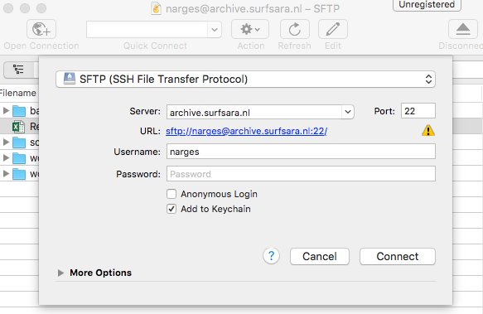
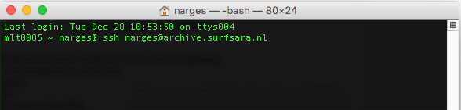
Data Archive Access
Access via graphical user interface (GUI)
A transfer client that support SSH File Transfer Protocol (SFTP)
Cyberduck (Mac and Windows)
Filezilla (Linux)
MobaXterm (Windows)
Access via command line interface (CLI)
Terminal (preinstalled on Mac and Linux)
MobaXterm (Windows)
Access via NFS mounts (Also via command line, only possible from compute clusters, Lisa and Cartesius)

Slide 6
Access Archive via GUI
Cyberduck
Cyberduck is a standalone client that runs on Windows and Mac OSX
Download and install: http://cyberduck.ch/
To start an Archive session with Cyberduck:
Start Cyberduck
Click on 'Open connection'
You now see this screen
Choose the following options:
Connection type: SFTP (SSh File Transfer Protocol)
Server: archive.surfsara.nl
port: 22
Login with your credentials (sdemo<xxx>)

Slide 7
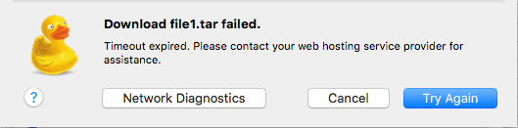
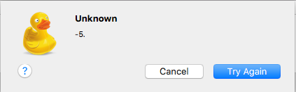
Transfer Data using Cyberduck
Error: If the file is on tape, and not on disk. The files needs to be stages first.
Error: If the internet connection is lost.
Notes:
Via GUI you can’t see the file specifications on the server. Such as if a file is on tape or on disk. This causes unclear errors that might be difficult to root cause and resolve.

Slide 8
Advantages & Limitations of GUI access
Advantages:
Easy data transfer (to the archive)
Good for dumping data to the archive, and not fetching data
Transfer data between services (Only possible for small data)
Can be accessed from Windows, Mac and Linux machines
Limitations
The data flows via the user laptop. Therefore the transfer depends on your local storage and connectivity (If the connection is lost, the transfer is lost).
Only for small data files
Does not always work for fetching data (data needs to be staged first)
You can't see the status of the data (i.e. weather the data is on disk or on tape).
Data flow
Server 1
( Beehub)
Server 2
(Archive)

Slide 9
Archiving Workflow
In all cases:
User logs in to Lisa / Cartesius
User’s archive home folder is mounted as folder /archive/<username>
Storing data:
Pack your data using tar or “dmftar” locally
Copy to archive
Retrieving data:
Stage archived data (“dmget” command)
Unpack using tar or “dmftar”
Direct archive access:
archive.surfsara.nl (CLI)
Lisa/Cartesius
Tape
Staging
Login
Disk

Slide 10
Optimal archiving using dmftar
dmftar is …
Wrapper for GNU tar, developed in-house by SURFsara.
Creates archive files of any size (default 10 GB).
Can transfer data automatically to and from the archive file system.
Available on Data Archive, Lisa cluster or Cartesius supercomputer.
Contains the same information as tarballs, plus more:
Checksum of each tarball (default checksum algorithm is md5, but others are supported as well, i.e sha1, sha224,…)
File index: list of files and directory structure
Understands underlying storage infrastructure: ‘tape-aware’
Automatically stages your archived files
Notes:
default checksum algorithm used by dmftar is md5, but others are supported as well:
md5 sha1 sha224 sha256 sha384 sha512

Slide 11
Archiving tools: comparison
tar:
Available everywhere!
All Linux distributions and OS X by default
Windows requires installation: Tar for Windows
dmftar:
Only available on Lisa / Cartesius / archive
Automates extra tasks concerning data archiving
Ideal for archiving data on the Data Archive!

Slide 12
Archiving tools: dmftar
tar syntax:
dmftar syntax:
Note: always use the right extension (‘tar’ and ‘dmftar’) for your archives!
tar [OPTIONS] <tarball> <input-files..>
dmftar [TASK] [OPTIONS] -f <dmftar-archive> <input-files>

Slide 13
Archiving tools: dmget & dmput
Staging data from tape on the archive:
Pushing data to tape on the archive:
Wildcards are accepted!
dmget –a [file]
dmput [-r] [file]

Slide 14
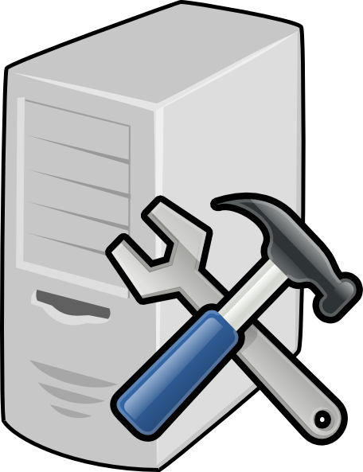
Hands-on: Archiving Data
Archiving data using dmftar
Login to LISA (command: ssh sdemoXXX@lisa.surfsara.nl)
Explore the environment
Connection to archive
DMF commands
Start an archiving workflow
Data Archive
LISA
Disk
login
Archiving
Link to the hands on material: https://goo.gl/UPoYru

Slide 15

Thank you!
Thanks to:
Christine Staiger (SURFsara)
Hans van Piggelen (SURFsara)
Jeroen Engelberts (SURFsara)

